Slide 1


TIFFANY
Database Management System
by Pokébowl&Milktea
Han Mo
Ruixue Qin

Slide 2
01
Background
TIFFANY
02
Data Model
CONTENTS
03
Front-End Mockup
04
Business Question

Slide 3

Background
TIFFANY is a is a luxury jewelry and specialty retailer. It sells jewelry, home goods, fragrances, watches, personal accessories etc. The database is mainly designed to help the retail management from two aspects, product and transaction.
The database will take care of the product departments, and document the product facts like price, collections, materials, descriptions and so on. On the other hand, transaction details including invoices, customers information and employees who help with the sales process can also be recorded and connected, which make things easier to produce reports later for further analysis.

Slide 4
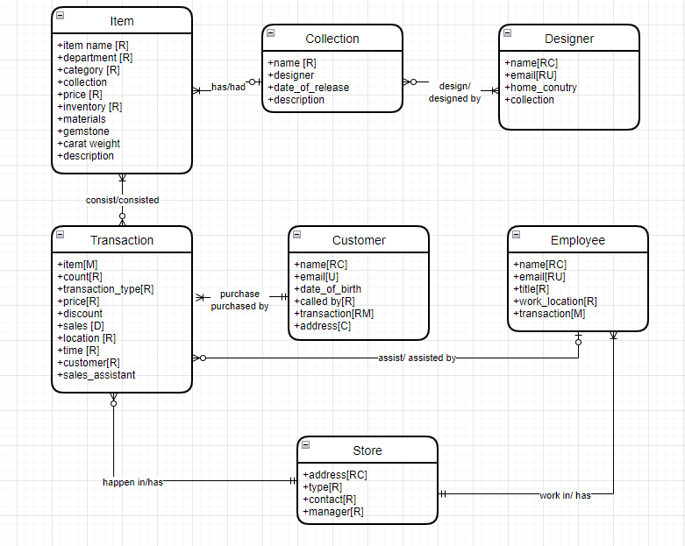
Conceptual Model

Slide 5
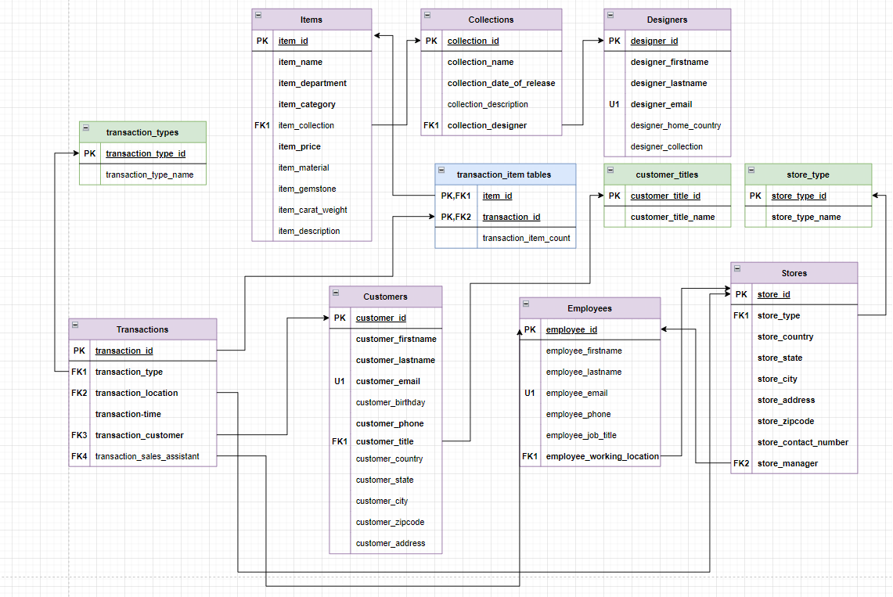
Logical Model

Slide 6
Data Dictionary
Table: items
Column Name | Data Domain | Comments
item_id | Surrogate key not null | Will be the primary key
item_name | Varchar length 20 not null | item name
item_department | Varchar length 20 not null | departmrnt of the company
item_category | Varchar length 20 not null | category of the item
item_collection | Int null | which collection belongs to
item_price | Money not null | price the the item
item_materials | varchar(20) null | what kinds of materials item use
item_gemstone | varchar(20) null | what kind of stone item use
item_carat_weight | float null | how much does item weight
item_description | Varchar length 150 null | the detailed descprtion of the item
Constraint Name | Type | Comments
pk_item_id | Primary key on item_id | Enforces pk over surrogate key on table
fk_items_item_collection | Foreign key references collection_lookup table | A lookup table to restrict collections
ck_items_item_prices | Check item_price >0 | we only consider positive price

Slide 7
Data Dictionary
Table: collections
Column Name | Data Domain | Comments
collection_id | Surrogate key not null | Will be the primary key
collection_name | Varchar length 50 not null | name of collection
collection_designer | int not null | the designer who leads the collection
collection_date_release | date not null | date the collection release
collection_description | Varchar length 150 null | the detailed descprtion of the collection
Constraint Name | Type | Comments
pk_collections_collection_id | Primary key on collection_id | Enforces pk over surrogate key on table

Slide 8
Data Dictionary
Table: designers
Column Name | Data Domain | Comments
designer_id | Surrogate key not null | Will be the primary key
designer_firstname | Varchar length 50 not null | firstname of the designer
designer_lastname | Varchar length 50 not null | lastname of the designer
designer_email | Varchar length 50 not null | designer's email, Natural key
designer_home_country | Varchar length 50 not null | the home country of designer
Constraint Name | Type | Comments
pk_designers_designer_id | Primary key on designer_id | Enforce pk over surrogate key on table
u_designers_designer_email | Unique on designer_email | Enforces natural key to establish entity integrity

Slide 9
Data Dictionary
Table: transactions
Column Name | Data Domain | Comments
transaction_id | Surrogate key not null | will be the primary key
transaction_type | int not null | identify the transaction is a sale or return
transaction_time | date not null | when the transaction happened
transaction_location | Int not null | where the transaction happened
transaction_customer | Int not null | who made the purchase
transaction_sales_assistant | Int null | who helps the transation
Constraint Name | Type | Comments
pk_transactions_transaction_id | Primary key on transaction_id | Enforces pk over surrogate key on table
fk_transactions_transaction_type | Foreign key references transaction_type lookup table | A lookup table to define the transations is a sales of sales or return
fk_transactions_transaction_location | Foreign key references store lookup table | A lookup table to pinpoint where the transation happened
fk_transaction_transaction_customer | Foreign key references customer table | The customer who made the transaction
fk_transaction_transaction_sales_assistant | Foreign key references employee table | The employee who assists the transaction

Slide 10
Data Dictionary
Table: Transaction Type lookup
Column Name | Data Domain | Comments
transaction_type_id | Surrogate key not null | will be the primary key
transaction_type_name | varchar(10) not null | it is a sales or retrun
Constraint Name | Type | Comments
pk_transaction_type_id | Primary key on transaction_type_id | Enforces pk over surrogate key on table
u_transaction_type_name | Unique on transaction type name | each transaction type needs to be unique

Slide 11
Data Dictionary
Table: Transaction Item Bridge
Column Name | Data Domain | Comments
transaction_id | Int not null | make a pimary key with item_id
item_id | Int not null | make a pimary key with item_id
transaction_item_count | int not null | how many count of this item in current transaction
Constraint Name | Type | Comments
pk_transation_id_item_id | Primary Key on transaction_id
fk_transaction_item_transaction_id | Foreign key references transation table | what transation does the transaction this piece of item belongs to
fk_transaction_item_item_id | Foreign key references item table | what is the further detail of the item in this transaction

Slide 12
Data Dictionary
Table: customer
Column Name | Data Domain | Comments
customer_id | Surrogate key not null | will be the primary key
customer_firstname | Varchar 50 not null | firstname of customer
customer_lastname | Varchar 50 not null | lastname of customer
customer_email | Varchar 50 not null | Natural key
customer_birthday | date null | customer date of birth
customer_phone | Char 10 not null | customer's phone number
customer_title | int not null | what title the customer would like to be called
customer_country | Varchar 50 null | customer's country
customer_state | Varchar 50 null | customer's state
customer_city | Varchar 50 null | customer's city
customer_zipcode | Varchar 50 null | customer's zipcode
customer_address | Varchar 50 null | customer's address
Constraint Name | Type | Comments
pk_customer_customer_id | Primary key on customer_id | Enforces pk over surrogate key on table
u_customer_customer_email | Unique on cutomer email | every customer's email shall be unique
fk_customer_customer_title | Foreign key over customer_title refrence to customer_title lookup table | what title does the cutomer would like to be called

Slide 13
Data Dictionary
Table: customer title lookup
Column Name | Data Domain | Comments
customer_title_id | Surrogate key not null | will be the primary key
customer_title_name | varchar(10) not null | the title name cutomer can select from
Constraint Name | Type | Comments
pk_customer_title_id | Primary key on customer_title_id | Enforces pk over surrogate key on table
u_customer_title_name | Unique on transaction type name | each title name needs to be unique

Slide 14
Data Dictionary
Table: employee
Column Name | Data Domain | Comments
employee_id | Surrogate key not null | will be the primary key
employee_firstname | Varchar 50 not null | firstname of employee
employee_lastname | Varchar 50 not null | lastname of employee
employee_email | Varchar 50 not null | Natural key
employee_phone | Char 20 not null | employee's phone number
employee_job_title | Varchar 50 null | employee's position level
employee_working_location | Int not null | which store location the employee works at
Constraint Name | Type | Comments
pk_employee_employee_id | Primary key on employee_id | Enforces pk over surrogate key on table
u_employee_employee_email | Unique on eployee's email | every employee's email shall be unique

Slide 15
Data Dictionary
Table: store
Column Name | Data Domain | Comments
store_id | Surrogate key not null | will be the primary key
store_type | varchar not null | what kind of store it is
store_country | varchar not null | store country
store_state | varchar not null | store state
store_city | varchar not null | store city
store_address | varchar not null | store address
store_zipcode | char(10) not null | store zipcode
store_contact_number | char (10) not null | contact number of the store
store_manager | Int not null | the id of employee as manger of the store
Constraint Name | store | Comments
pk_store_store_id | Primary key on employee_id | Enforces pk over surrogate key on table
fk_store_store_type | Foreign key references store type lookup table | A lookup table to define the store type
fk_store_store_manager | Foreign key references employee table | who takes charge of the store

Slide 16
Data Dictionary
Table: store type look up
Column Name | Data Domain | Comments
store_type_id | Surrogate key not null | will be the primary key
store_type_name | varchar not null | flatship or authorized retailer or depatment store
Constraint Name | store | Comments
pk_store_type_id | Primary key on employee_id | Enforces pk over surrogate key on table
U_store_type_name | Unique on store type name | Each store type name needs to be unique

Slide 17
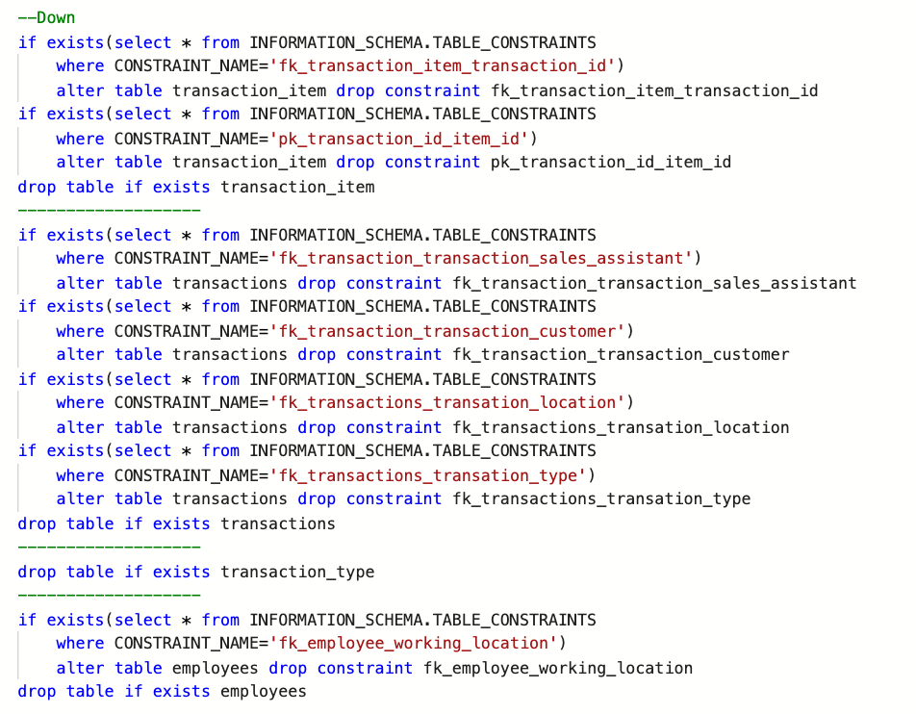
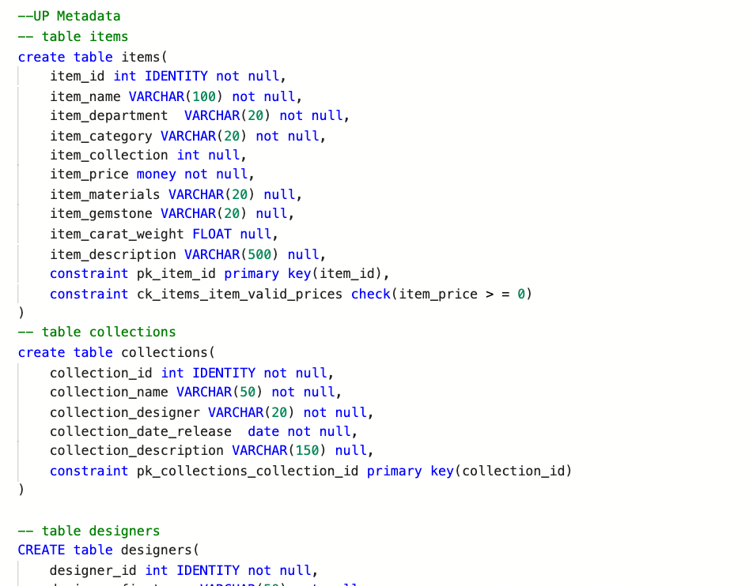
Up/Down script

Slide 18
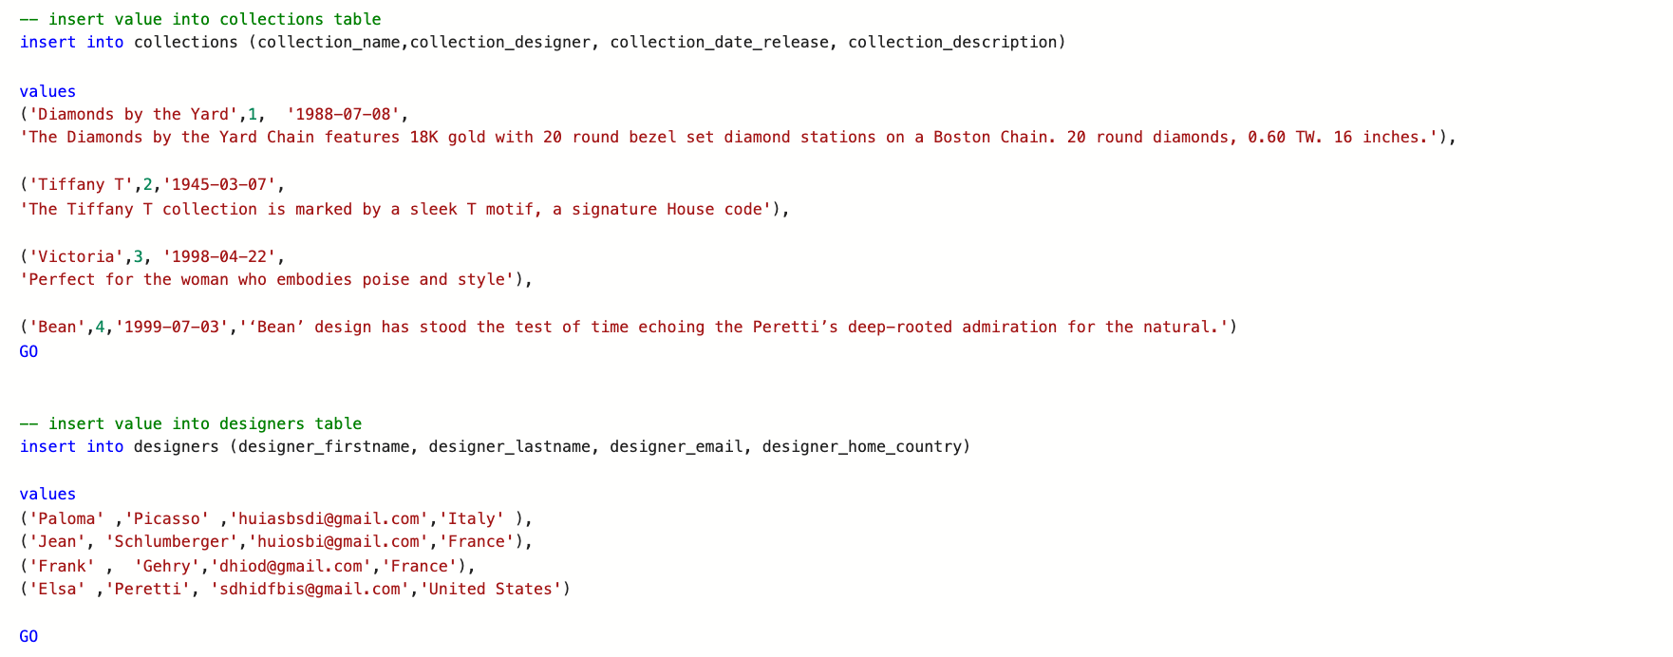
Value Insert

Slide 19
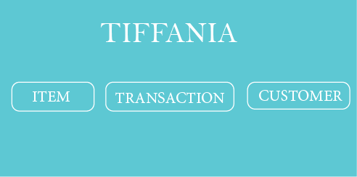
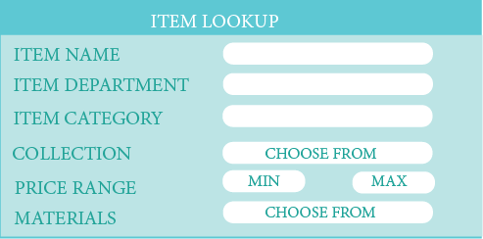
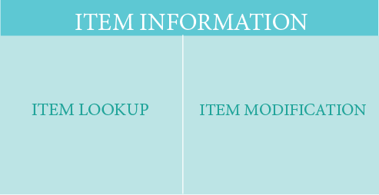
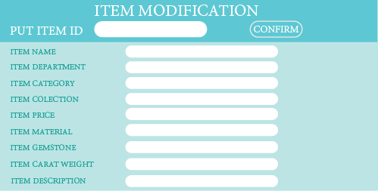
Mock-up

Slide 20
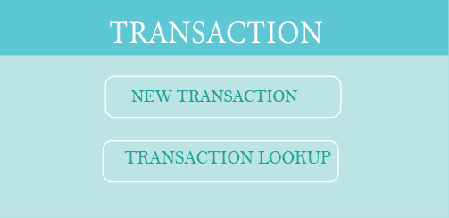
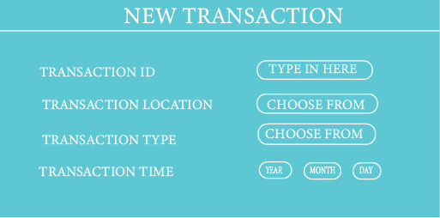
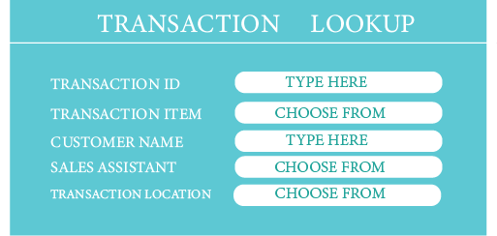
Mock-up

Slide 21
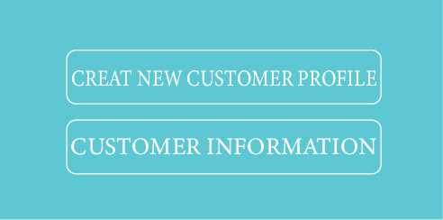
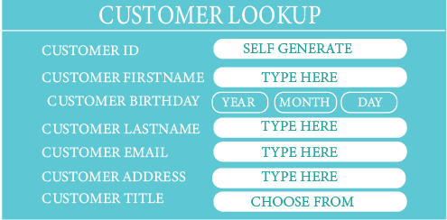
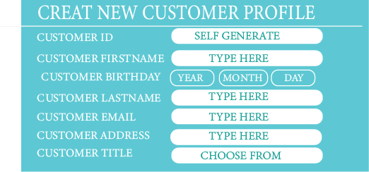
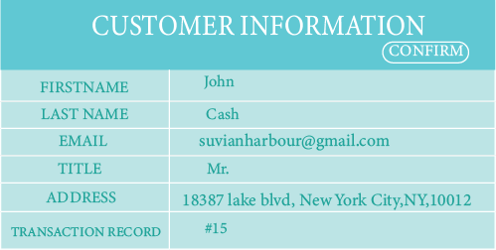
Mock-up

Slide 22
BUSINESS QUESTIONS

Slide 23
Give me a list customer who made purchase over $5000
With customer_purchase as(
select c.customer_id, c.customer_firstname, c.customer_lastname, c.customer_email,
sum(s.total_sales) over(partition by c.customer_id) as total_purchase
from transactions t
left join customers c on t.transaction_customer = c.customer_id
left join transaction_sales s on t.transaction_id =
s.transaction_item_transaction_id
)
select * from customer_purchase
where total_purchase >= 5000
order by total_purchase desc

Slide 24
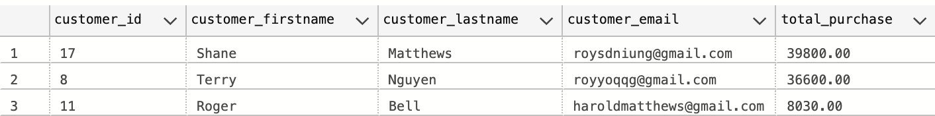
Give me a list customer who made purchase over $5000

Slide 25
2. Rank the employees regarding to value of purchases they have helped with
select t.transaction_id, e.employee_id, e.employee_firstname,
e.employee_lastname, e.employee_job_title,s.total_sales
from transactions t
left join employees e on t.transaction_sales_assistant = e.employee_id
left join transaction_sales s on t.transaction_id =
s.transaction_item_transaction_id
order by s.total_sales desc

Slide 26
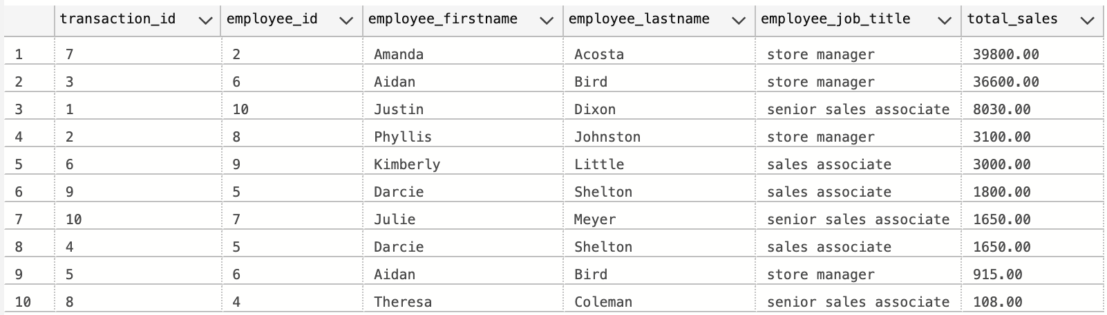
2. Rank the employees regarding to value of purchases they have helped with

Slide 27
3. Gift choice: what is the best selling item in jewelry under $500?
with item_sold as(
select distinct i.transaction_item_item_id,
sum(i.transaction_item_count) over (PARTITION by i.transaction_item_item_id) as count_of_item_sold
from transaction_item i
group by i.transaction_item_item_id, i.transaction_item_count
)
select item_id, item_name, item_department, item_price, item_materials, item_gemstone, item_carat_weight
from item_sold
left join items on item_sold.transaction_item_item_id = items.item_id
where items.item_price < 500 and item_department = 'Jewelry'

Slide 28
3. Gift choice: what is the best selling item in jewelry under $500?
NOTHING LEFT!!!

Slide 29
3. Gift choice: what is the best selling item in jewelry under $1000?
with item_sold as(
select distinct i.transaction_item_item_id,
sum(i.transaction_item_count) over (PARTITION by i.transaction_item_item_id) as count_of_item_sold
from transaction_item i
group by i.transaction_item_item_id, i.transaction_item_count
)
select item_id, item_name, item_department, item_price, item_materials, item_gemstone, item_carat_weight
from item_sold
left join items on item_sold.transaction_item_item_id = items.item_id
where items.item_price < 1000 and item_department = 'Jewelry'

Slide 30
3. Gift choice: what is the best selling item in jewelry under $1000?
Diamond!
Jewelry!
Platinum!

Slide 31
QUESTIONS?

Slide 32
Thank you for listening :D

